Slide 1
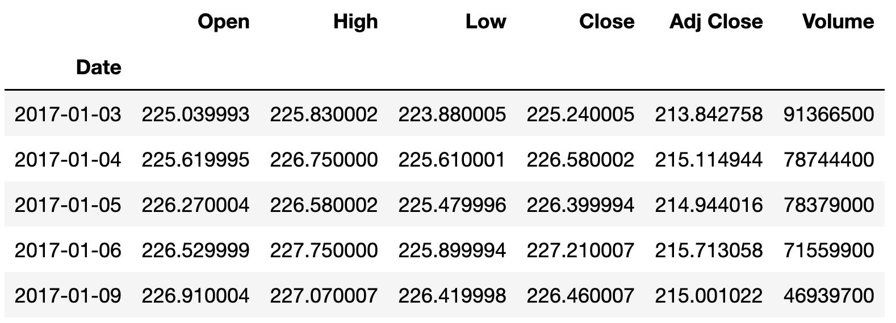
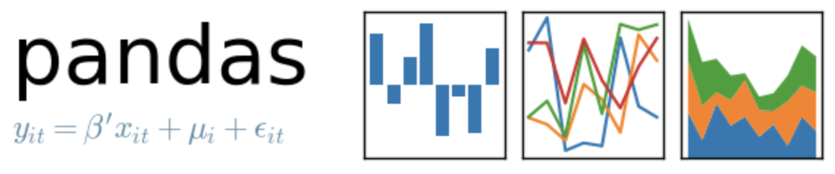
How to get Yahoo Finance Data

Slide 2
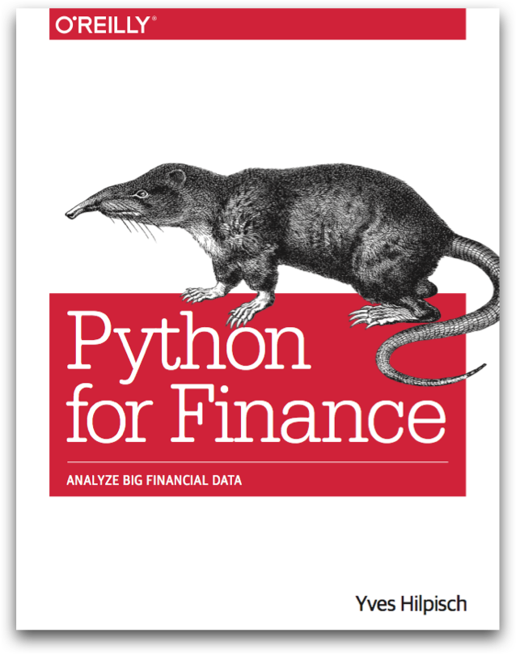
Reference
Python for Finance (O'Reilly)
yfinance
Youtube
Code

Slide 3
How to get Yahoo Finance Data
pandas_datareader
yfinance + pandas_datareader
yfinance

Slide 4
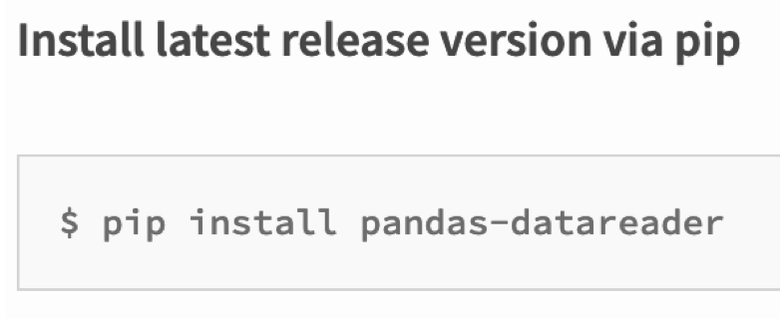
pandas_datareader

Slide 5
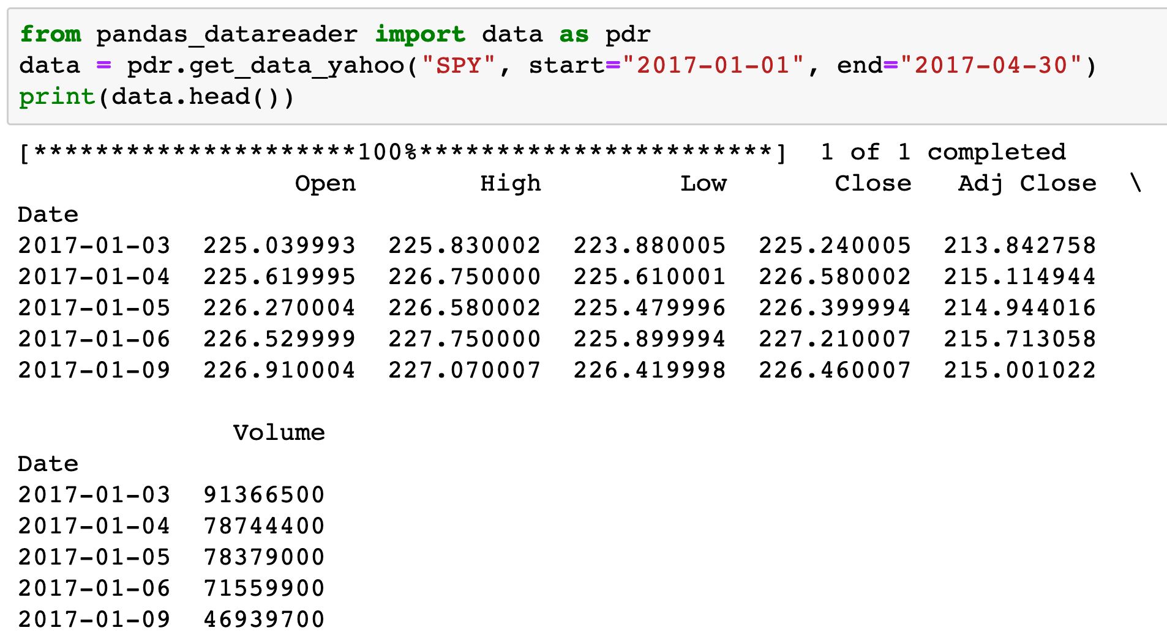
pandas_datareader

Slide 6
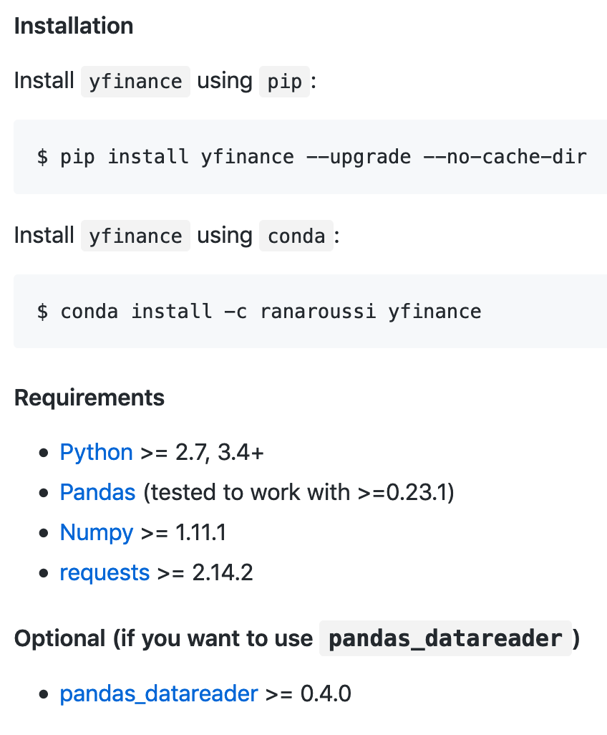
yfinance

Slide 7
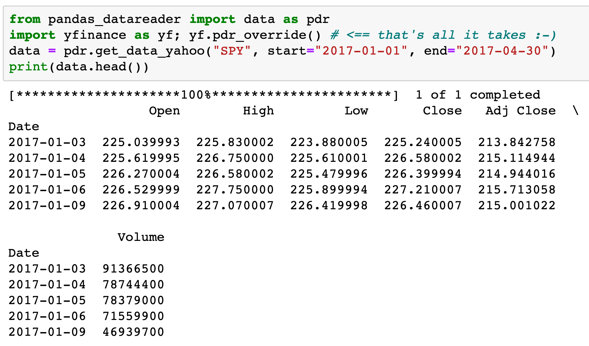
yfinance + pandas_datareader

Slide 8
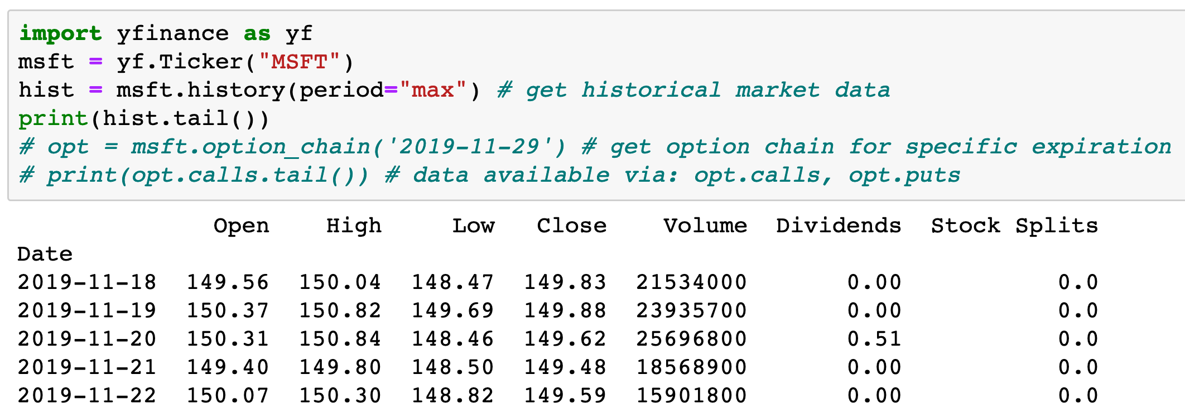
yfinance

Slide 9
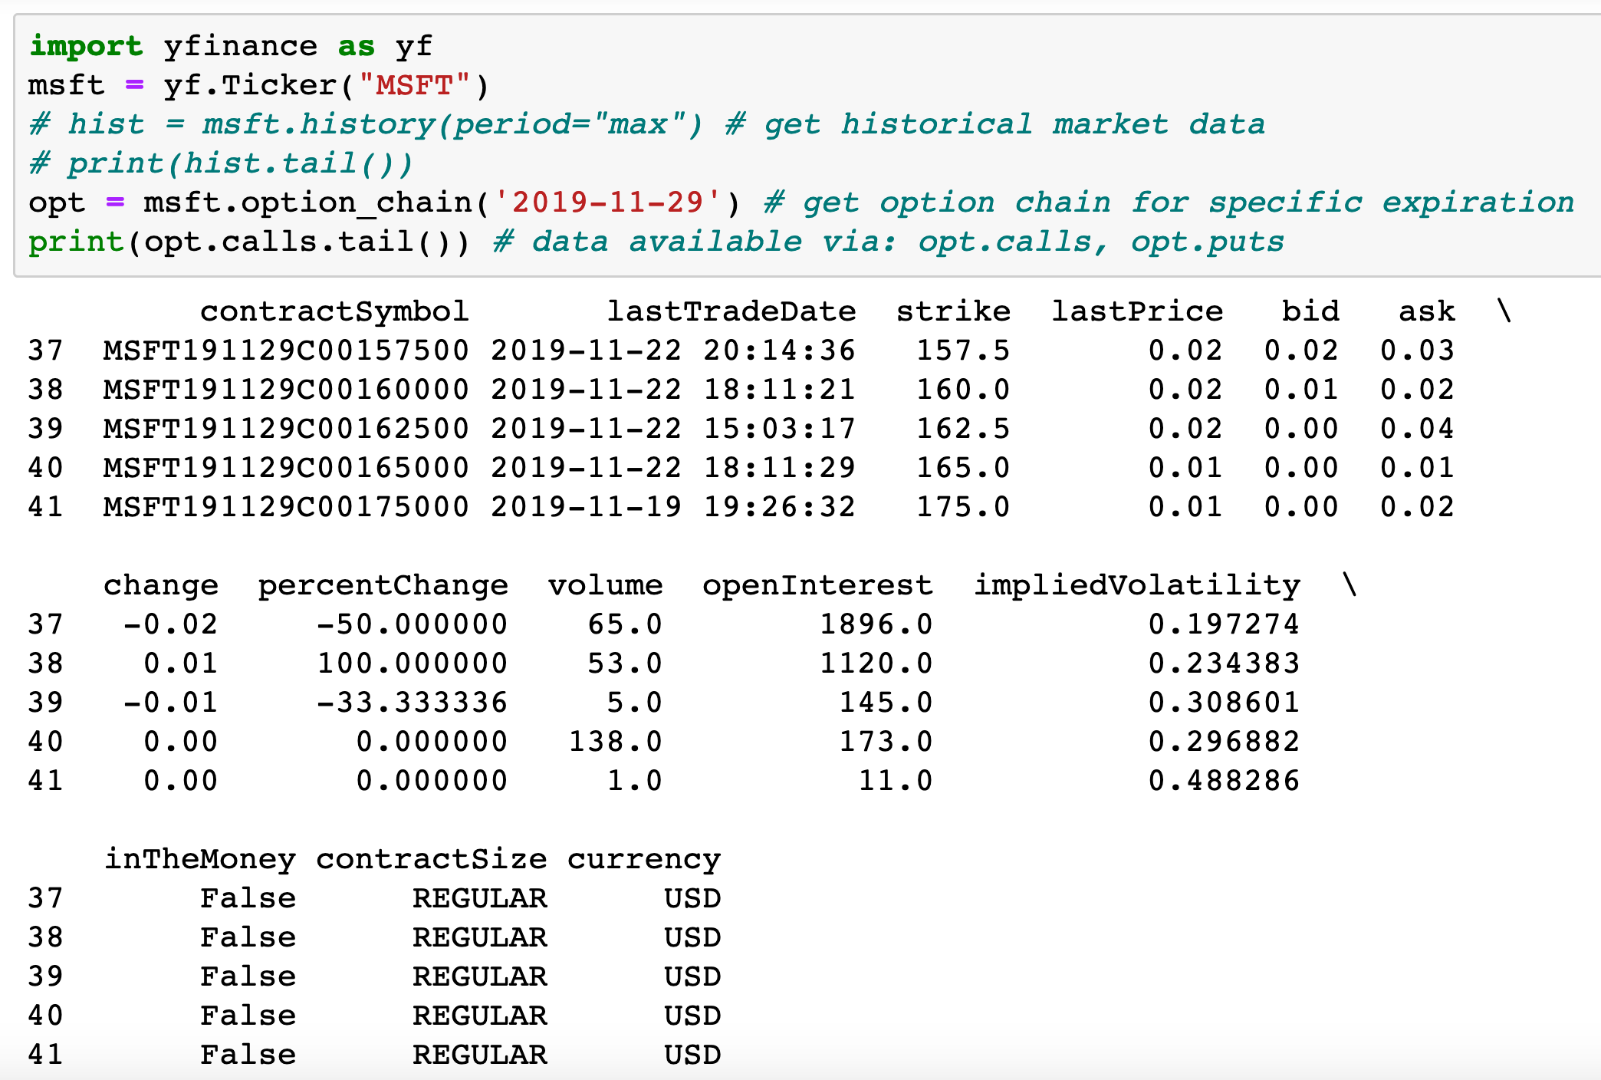
yfinance

Slide 10
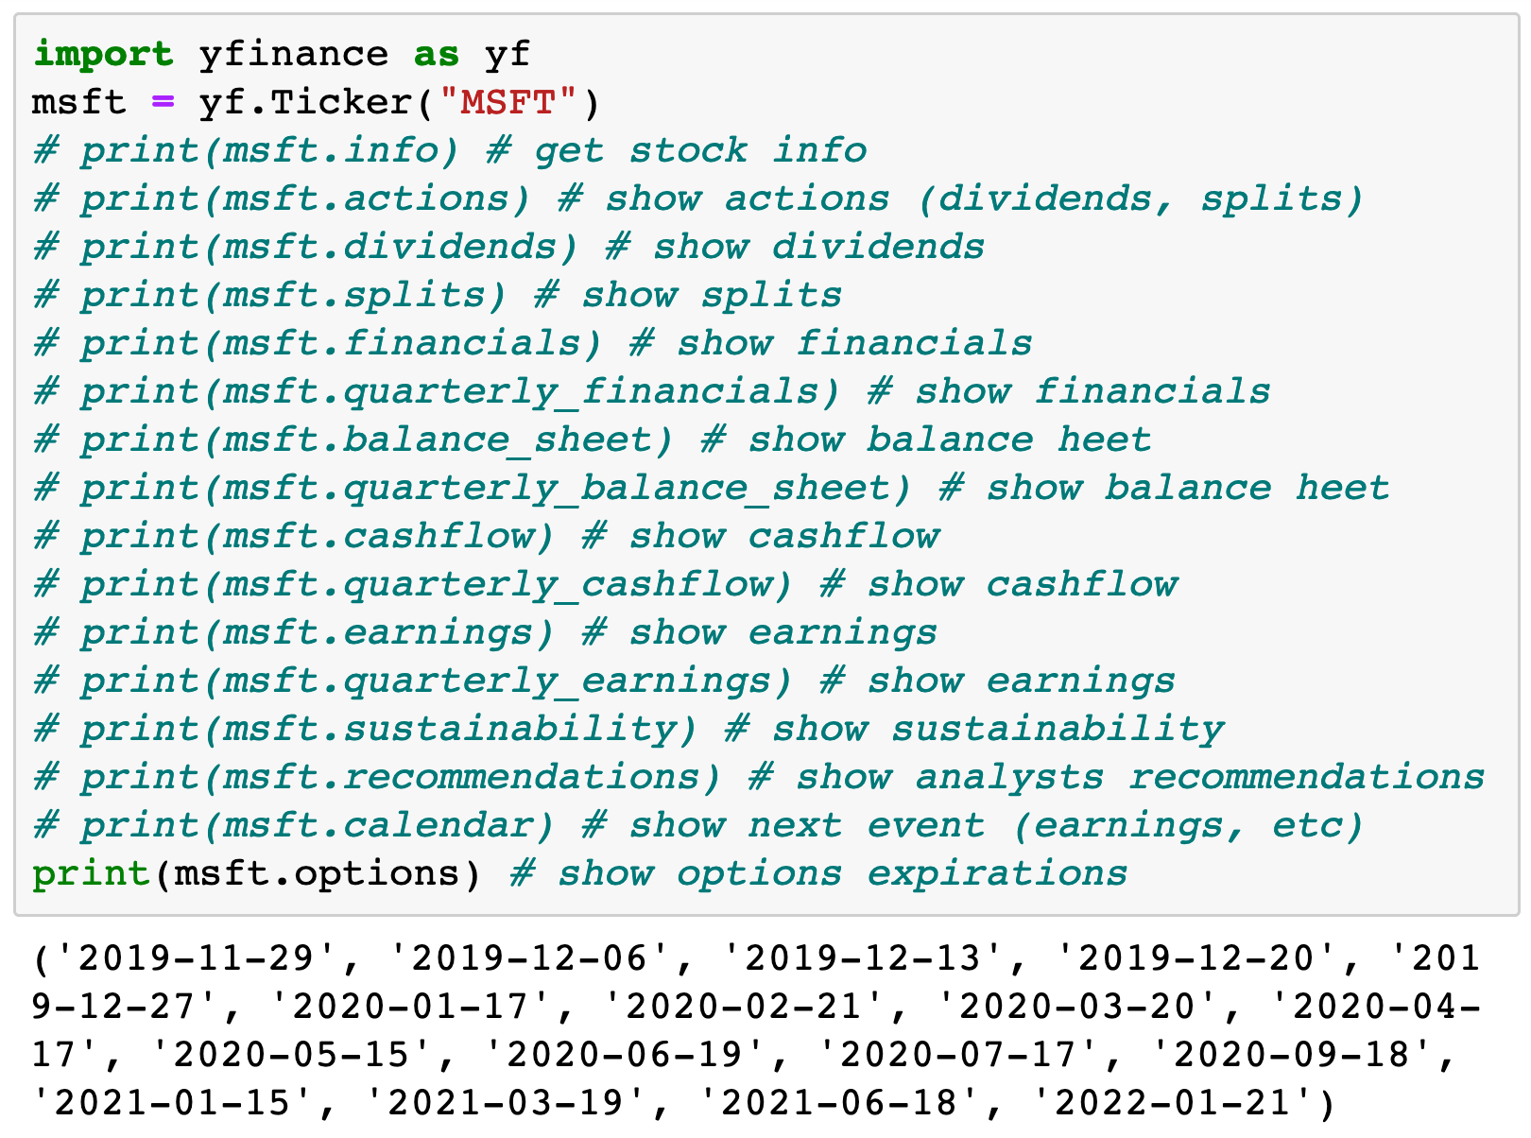
yfinance

Slide 11
Now
Let’s Play with Code

